Slide 1


SAP UI5 & FIORI with OData TRAINING
Anubhav Oberoy
Day – 15

Slide 2

Agenda – Day 15
Implementing Get Entity and EntitySet Methods.
Method of Calling Funciton module
Basics of Connectivity
Steps to Setup the Cloud Connection.
Creating the destination in the BAS
Connecting with cloud connector in BTP
Integrating our Fiori App with the Odata service in BAS
Configuring ui5.yaml file to use oData service in VS Code
Implementing the Get Entity Set in UI
Getting the Association in UI
Implementing Create in the UI
Implementing Upadte in UI
Implementing Delete uisng UI
Calling Function Import form the UI
Introduction to GitHub
Creating a Git Repository in GitHub.

Slide 3
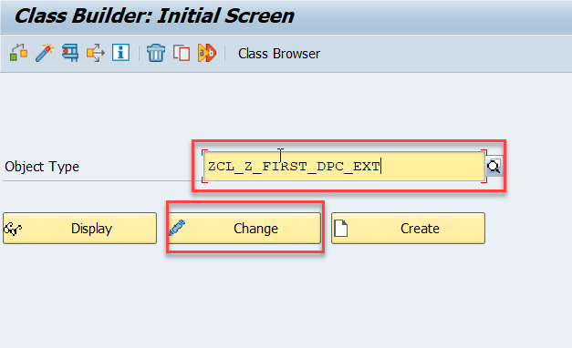
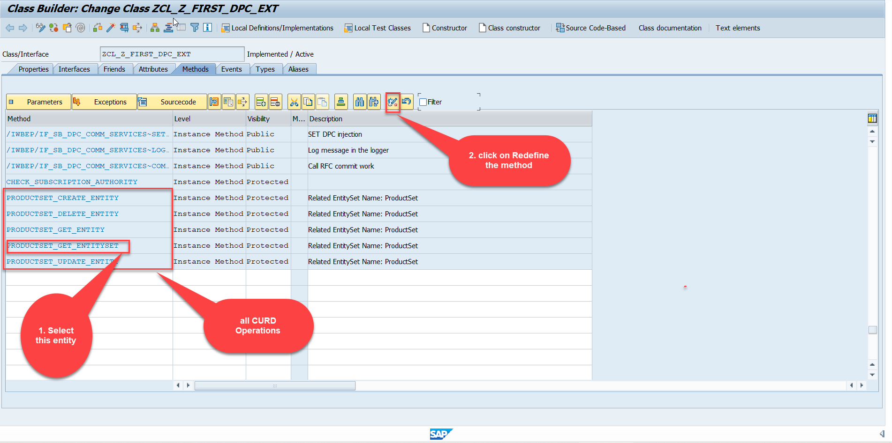
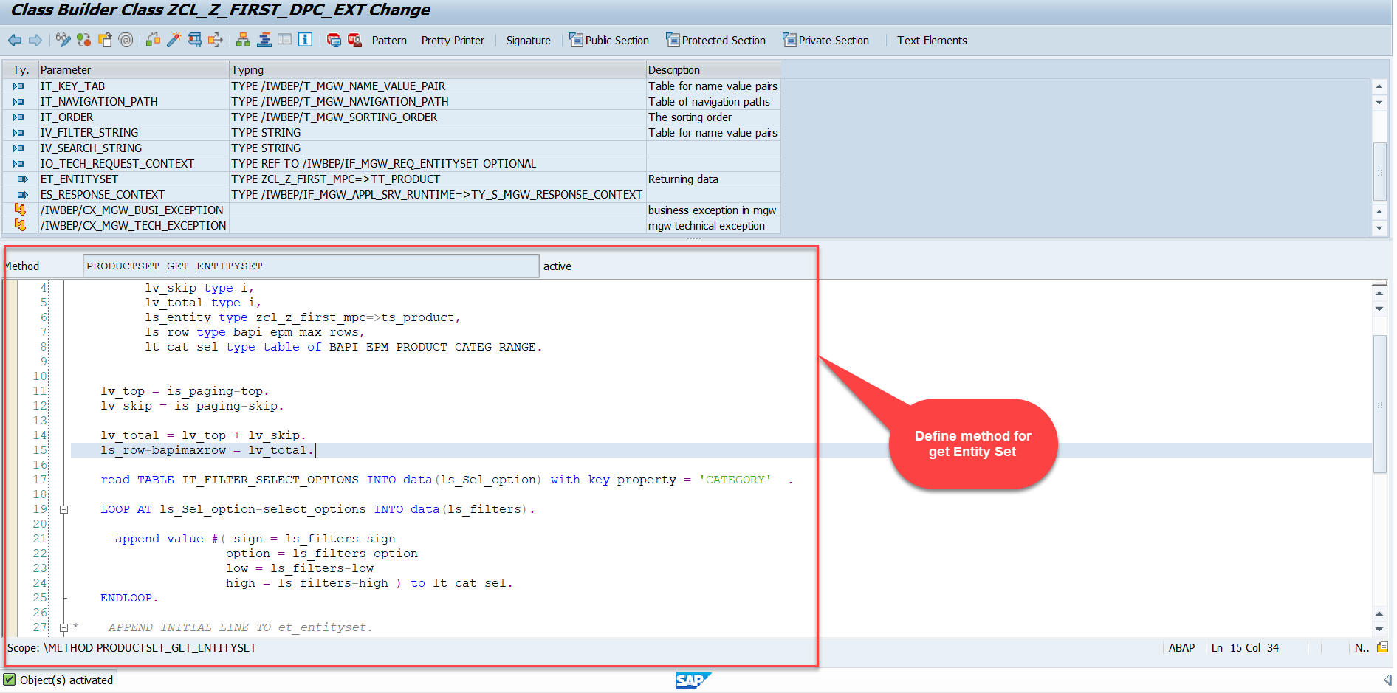
Building GetEntitySet Method
Step1: ProductSet Get Entity method(with filter, top and skip) in DPC Extension (Class Builder tcode- se24)
Code:
GetEntitySet

Slide 4
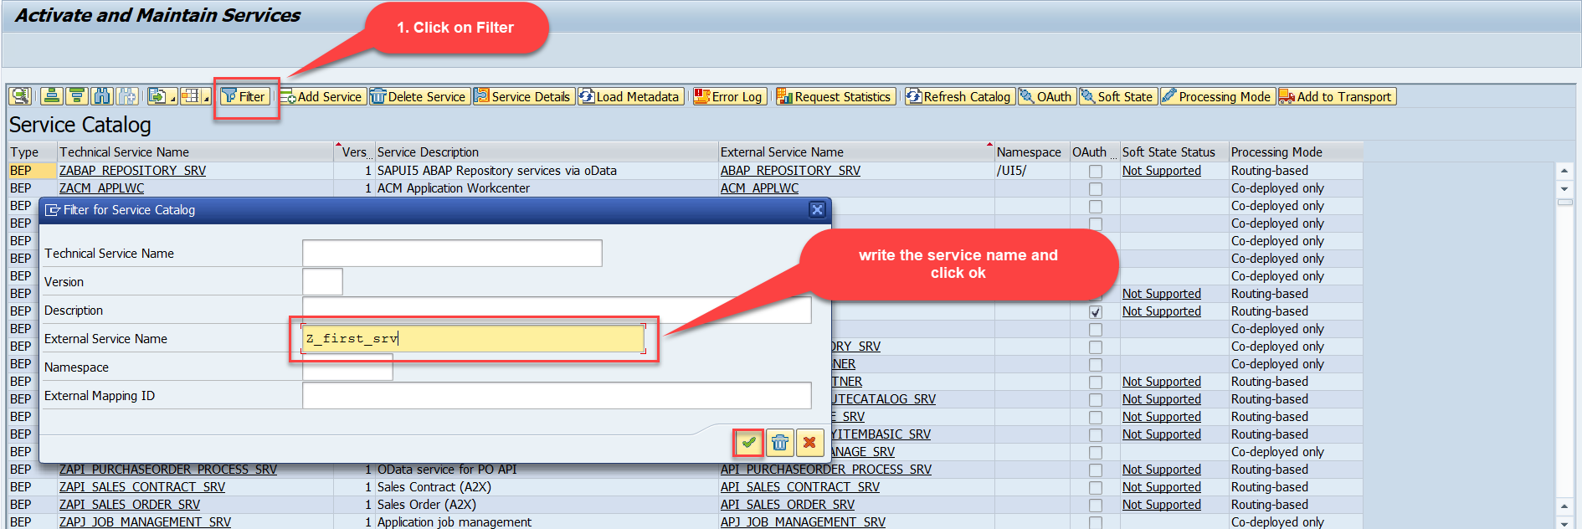
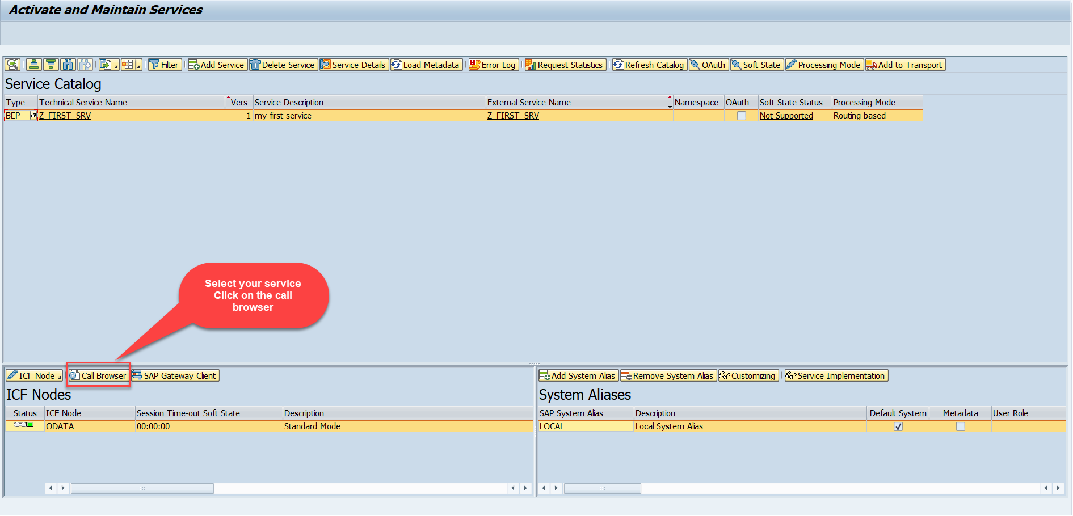
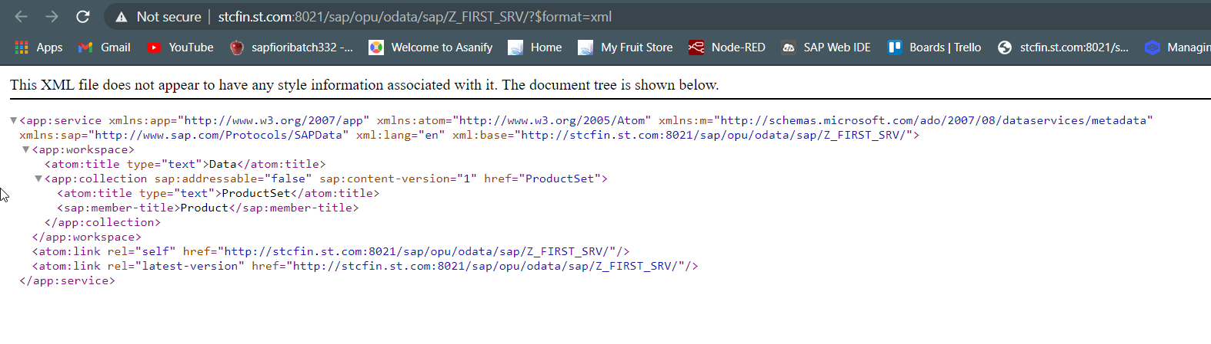
Building GetEntitySet Method Continue...
Step2: Call the service to the browser that we just created (go to service maintain (/iwfnd/maint_service))
Service in Browser

Slide 5
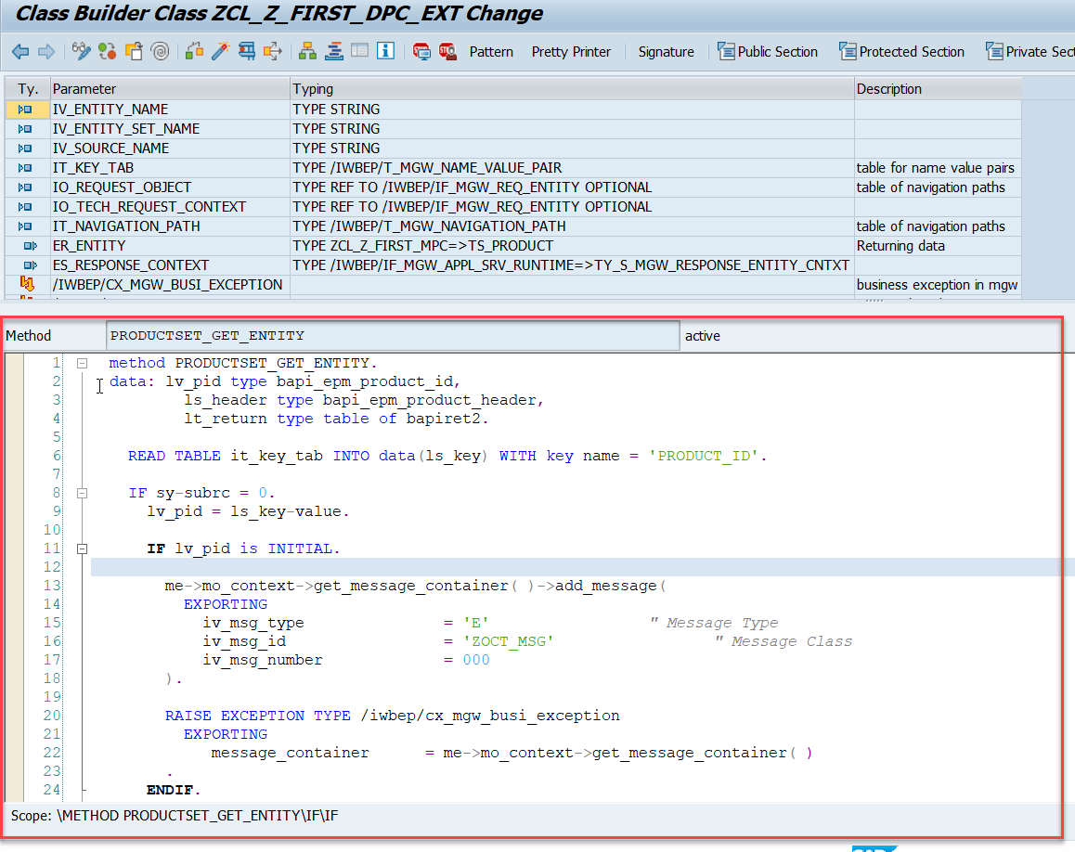
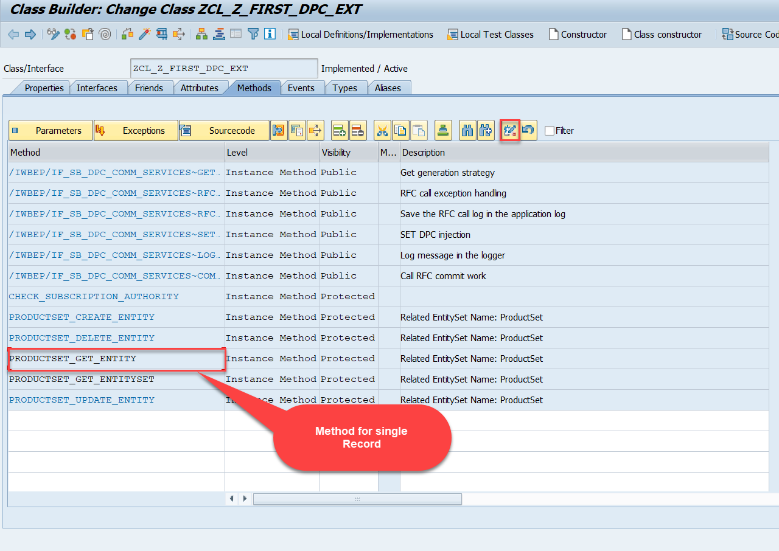
Building GetEntitySet Method Continue...
Go to DPC Extension of over service and redefine the method PRODUCTSET_GET_ENTITY
Code:
GetEntity

Slide 6
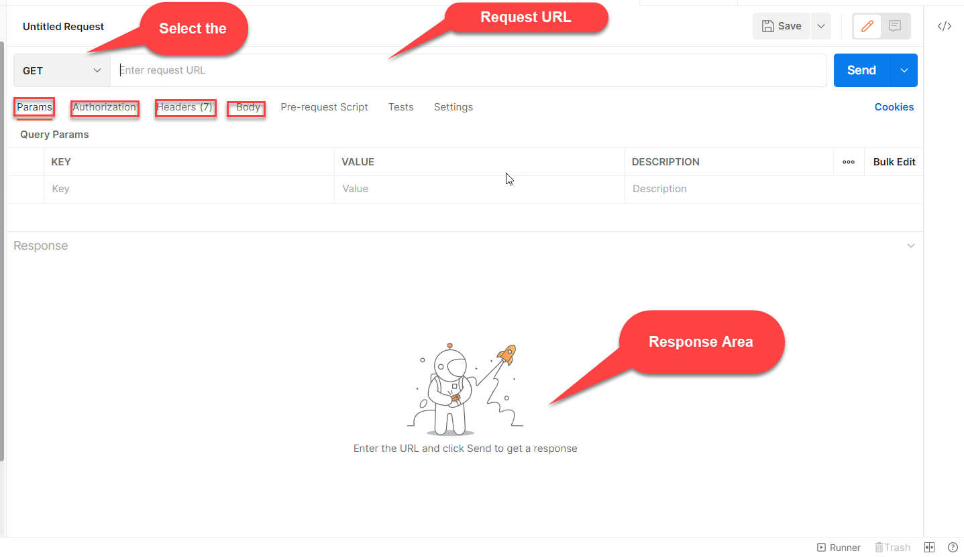

Postman
Postman is a free tool which can be used to test any kind of REST/OData Services outside of the system. This allows us to consume the data as if an external consumer would really do.
Postman is an API platform for building and using APIs. Postman simplifies each step of the API lifecycle and streamlines collaboration so you can create better APIs—faster.
As an ABAP developer, you can develop postman collection and deliver it to Fiori Developers for consumption to showcase, what our service is capable of.

Slide 7
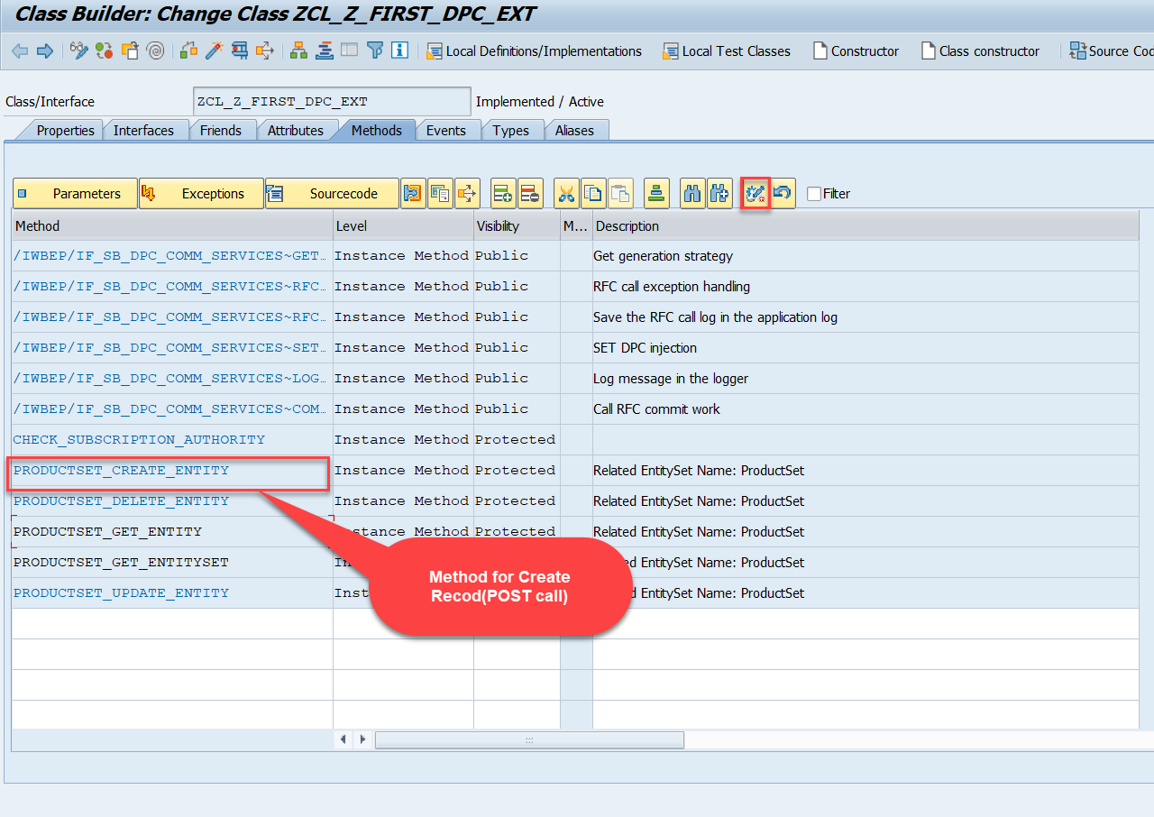
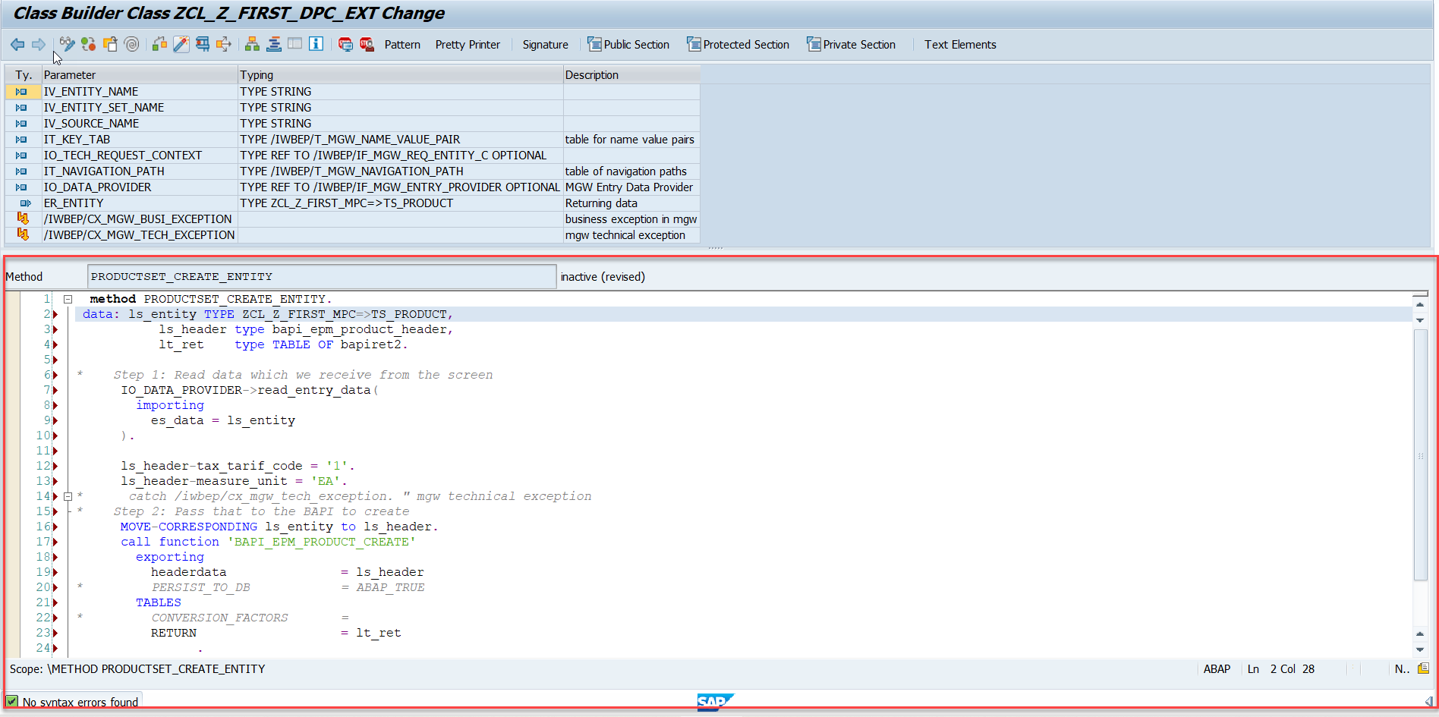
Building CreateEntity(POST) Method
Go to DPC Extension of over service and redefine the method PRODUCTSET_CREATE_ENTITY
Code: CreateProductEntity

Slide 8
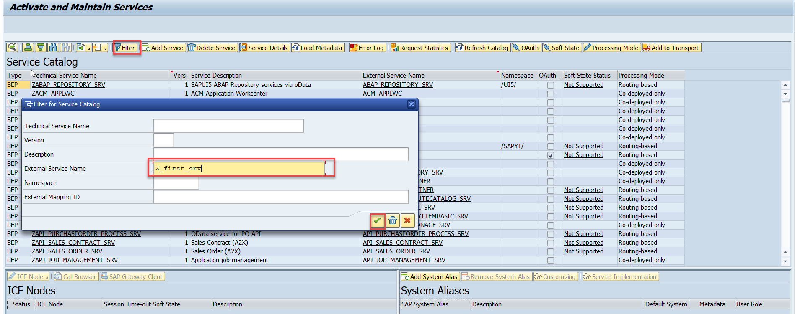
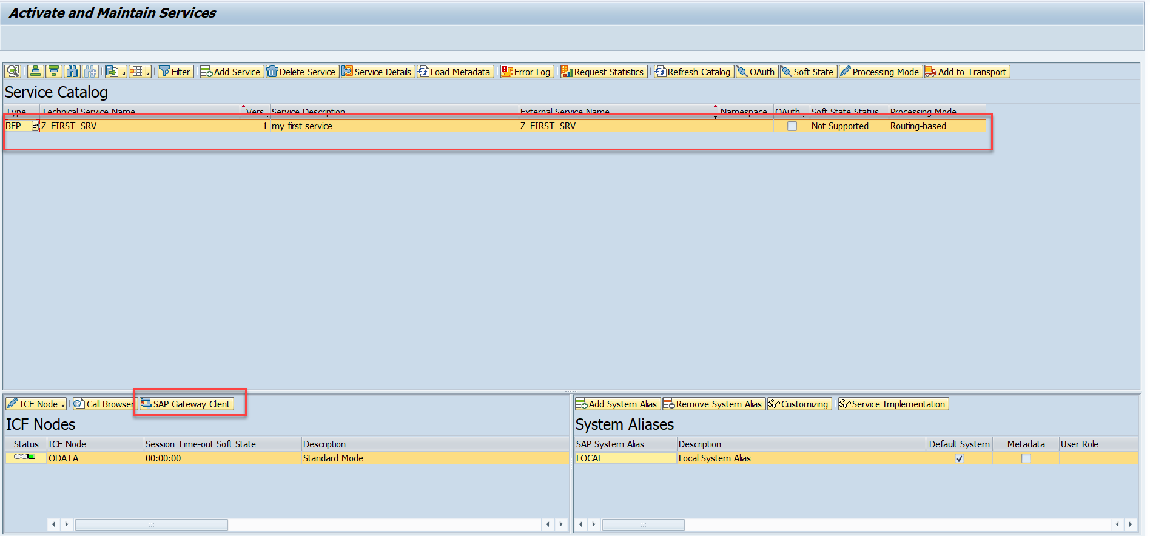
Testing Create Method at Sap Gateway client
Step:1 Go to sap service maintance(tcode- /iwfnd/maint_service) and search for the service and then select the service and click on the sap gateway client

Slide 9
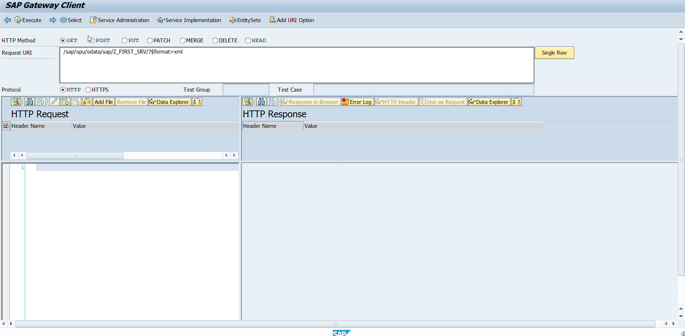
Testing Create Method Continue…
Step:2 Go to sap service maintance(tcode- /iwfnd/maint_service) and search for the service and then select the service and click on the sap gateway client

Slide 10
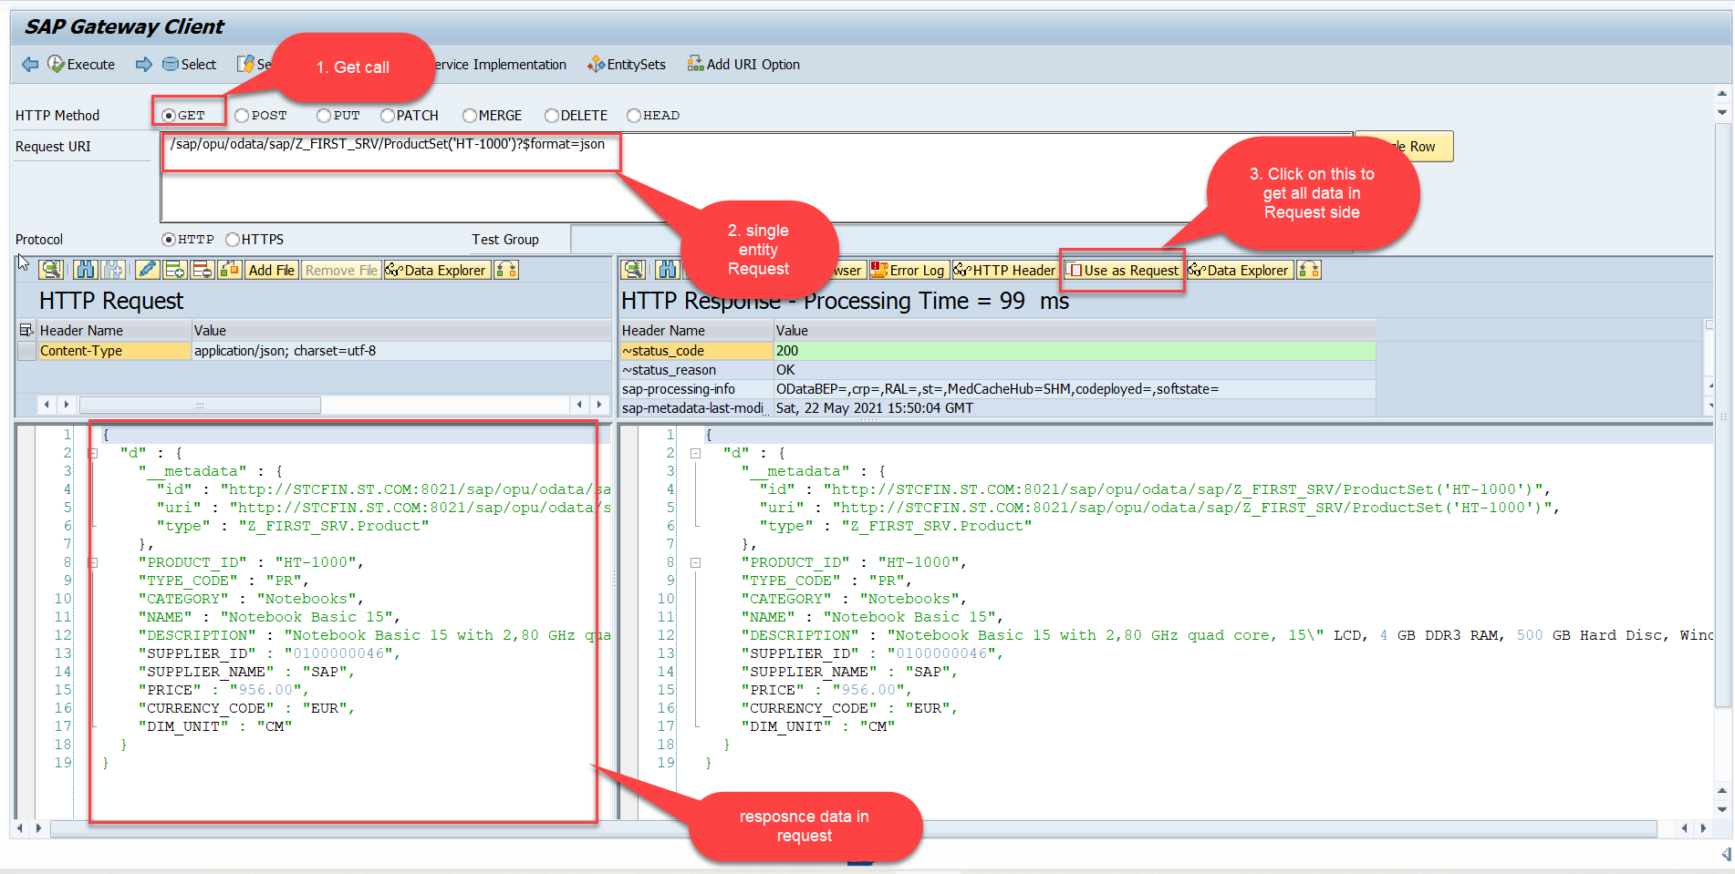
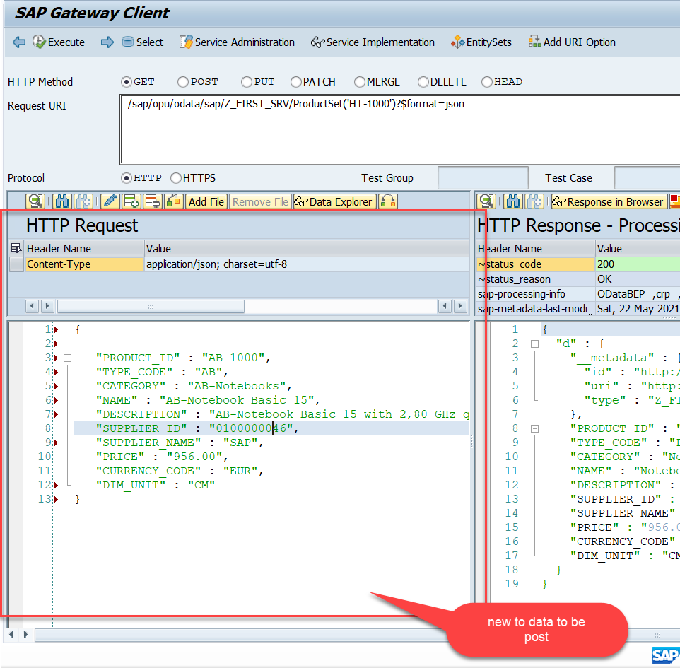
Testing Create Method Continue…
Step:3 Perform a getEntity in the Product set to get the payload to post (/sap/opu/odata/sap/Z_FIRST_SRV/ProductSet('HT-1000')?$format=json) and then clean the data and modify the payload as new.

Slide 11
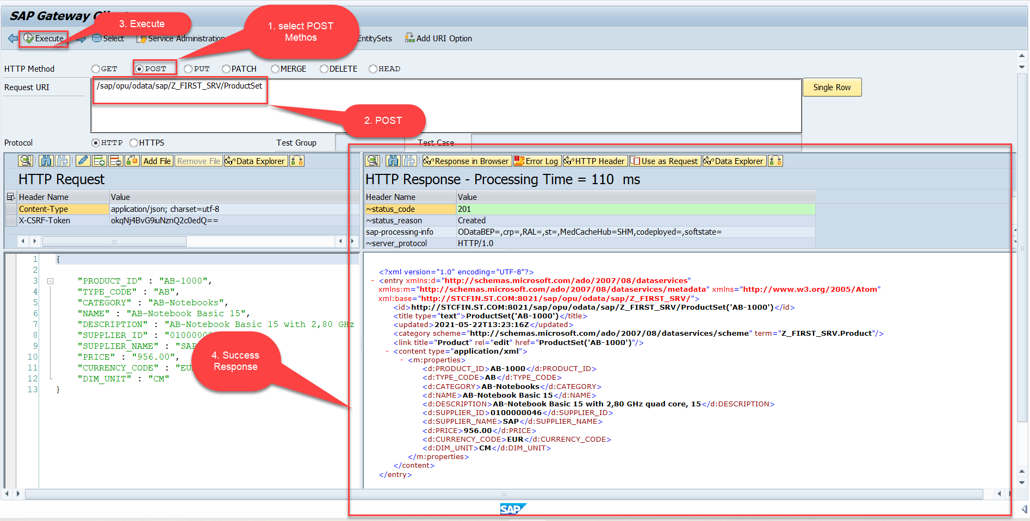
Testing Create Method Continue…
Step:4 send the post request at (/sap/opu/odata/sap/Z_FIRST_SRV/ProductSet)

Slide 12
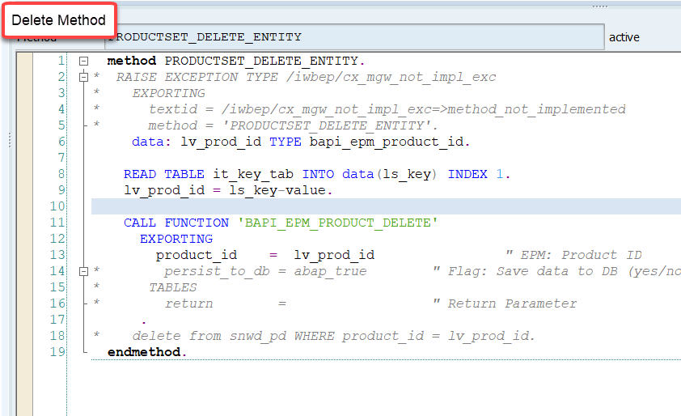
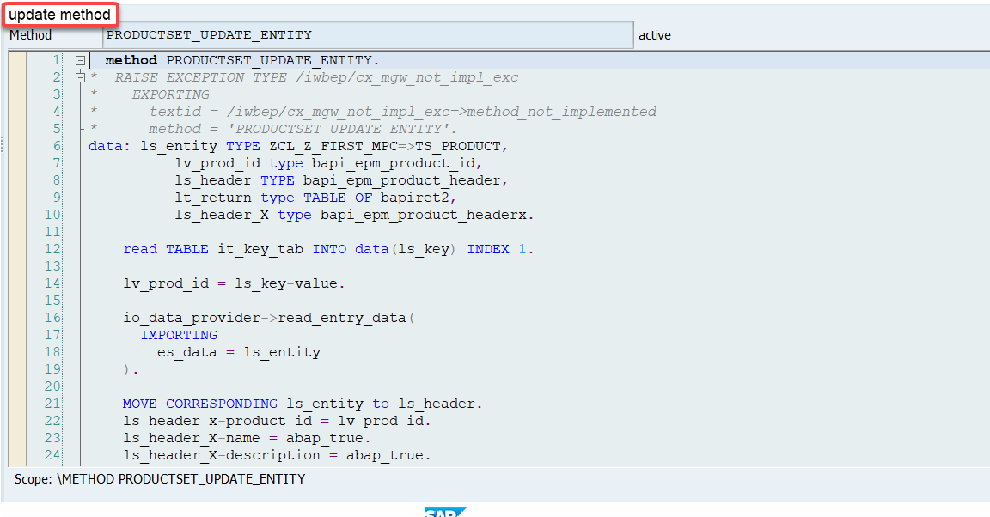
Implementing DELETE and Update (PUT) method
We can implement the delete and update method in the corresponding DPC extension classes.
Code: ProductSetDeleteEntity
Code: ProductSetUpdateEntity

Slide 13
Introduction to POSTMAN Tool
Postman is an API platform for building and using APIs. Postman simplifies each step of the API lifecycle and streamlines collaboration so you can create better APIs—faster.
It is an interactive and automatic tool for verifying the APIs of your project.
It presents you with a friendly GUI for constructing requests and reading responses. ... Postman is the way to streamline the process of API testing.
Postman can run GET, POST, PUT, PATCH, MERGE, DELETE, and various other request methods as well, and has utilities to help with developing APIs. Free and paid versions are available for Mac, Windows, Linux, and as a Chrome app.
You can Download the postman tool from the link give below:
https://www.postman.com/downloads/

Slide 14
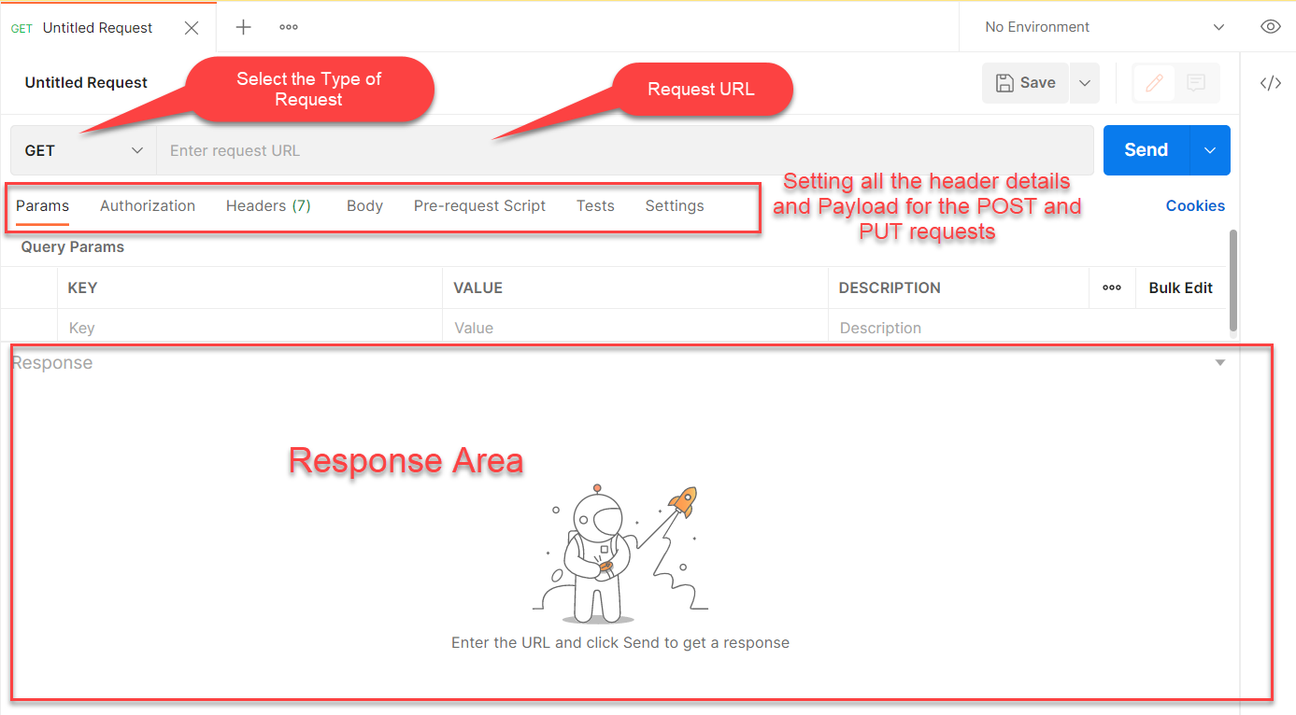
Postman App Layout
The below screen shot shows a basic layout of a request in Postman

Slide 15
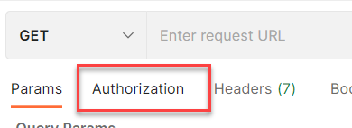
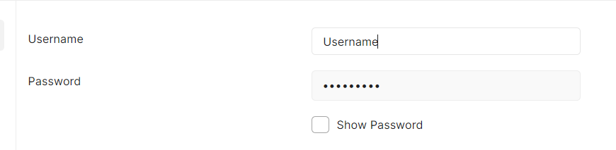
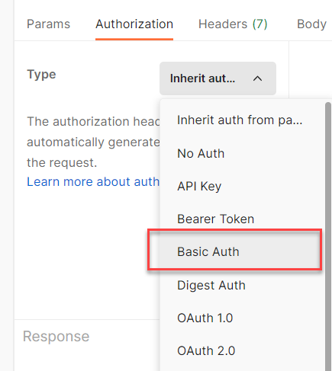
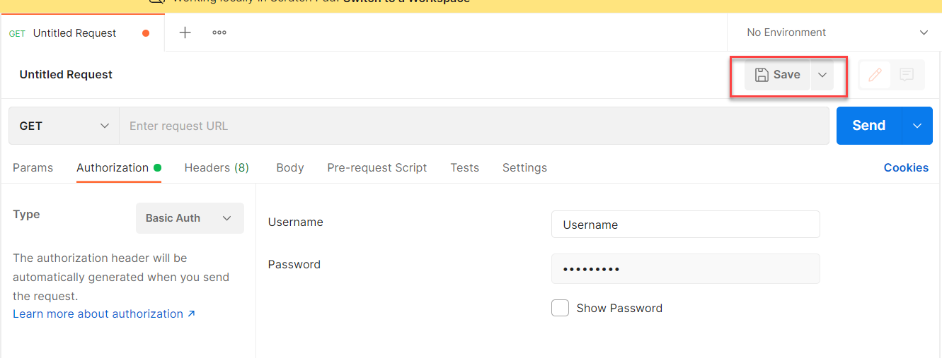
Setting Basic Auth in Postman
Step 1: Go to the Authorization section.
Step 3: Set the Username and Password.
Step 2: Select Basic Auth as Type
Step 4: Save.

Slide 16
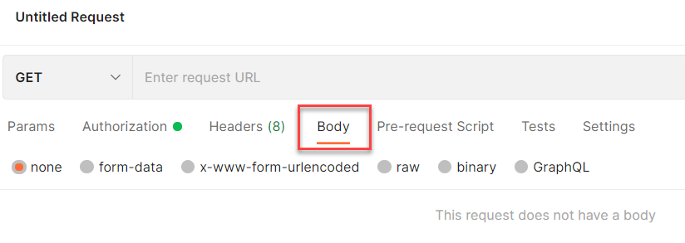
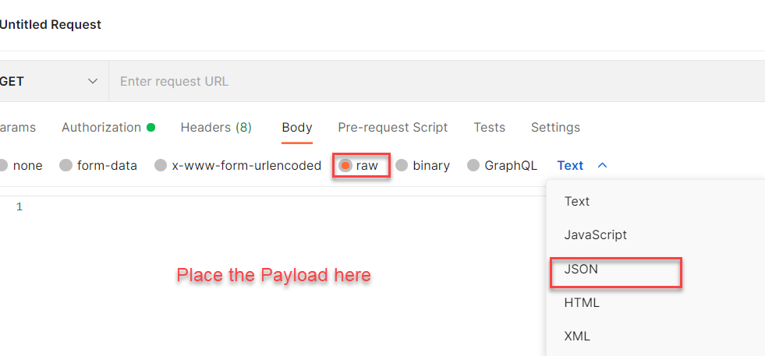
Setting the Payload for POST and PUT request
Step 1: Go to Body Section.
Step 2: Select the raw option form the radio button and then select the data type as JSON.

Slide 17
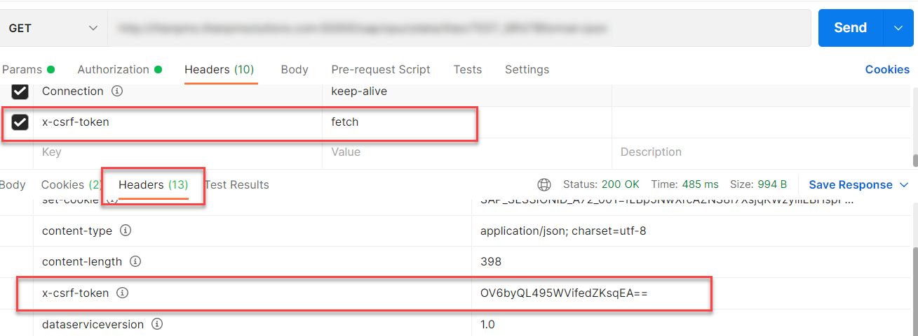
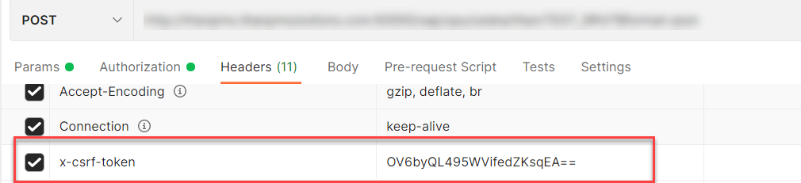
X-CSRF Token
A CSRF Token is a secret, unique and unpredictable value a server-side application generates in order to protect CSRF vulnerable resources.
The tokens are generated and submitted by the server-side application in a subsequent HTTP request made by the client.
Steps to Get the x-csrf token.
To get the x-csrf token we need to pass the value of x-csrf token as fetch with the GET call.
After executing the get call we will find the token in the Header Section of the Response.
- In POST call we need to pass this value of x-csrf token in the header section.

Slide 18
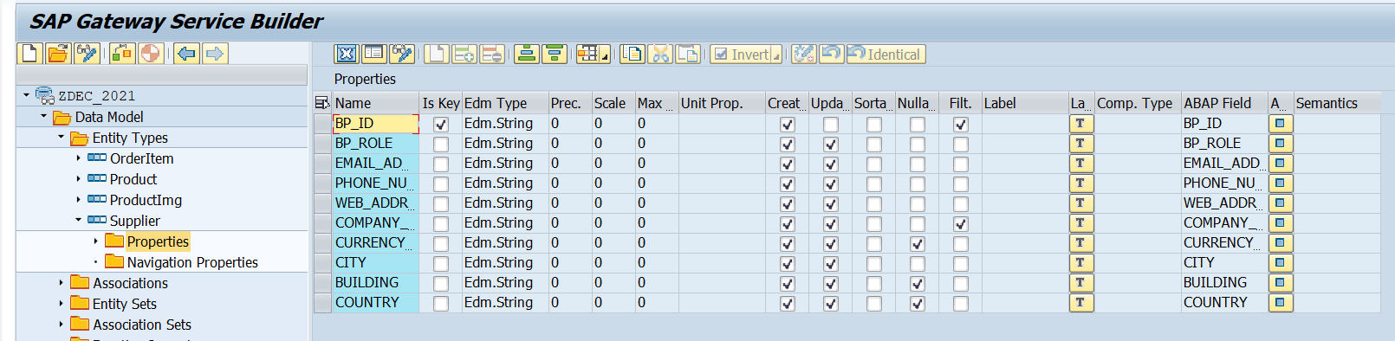
Create Supplier Set
Create a Supplier Set in the Entity Type Section by following the steps used to create Product Set.
Supplier Set
Once the Entity sets are created, we can also implement the Get Entity for of Supplier Set in the same way as we have created for the Product Set.
Code to Create Supplier Set Get Entity
SupplierSetGetEntity

Slide 19
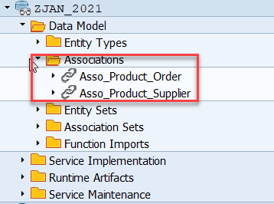
Association
Associations are relationship Between entities.
At database level we have foreign key relationship and same is reflected at odata level.
Once a association is created only then we can create navigation property.
Product
Supplier
1 relation 1
nav

Slide 20
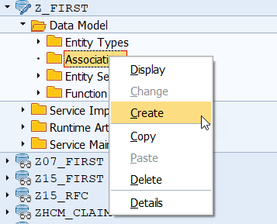
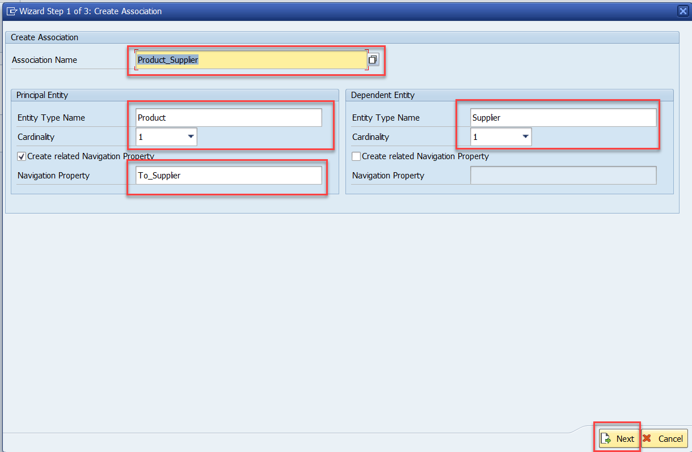
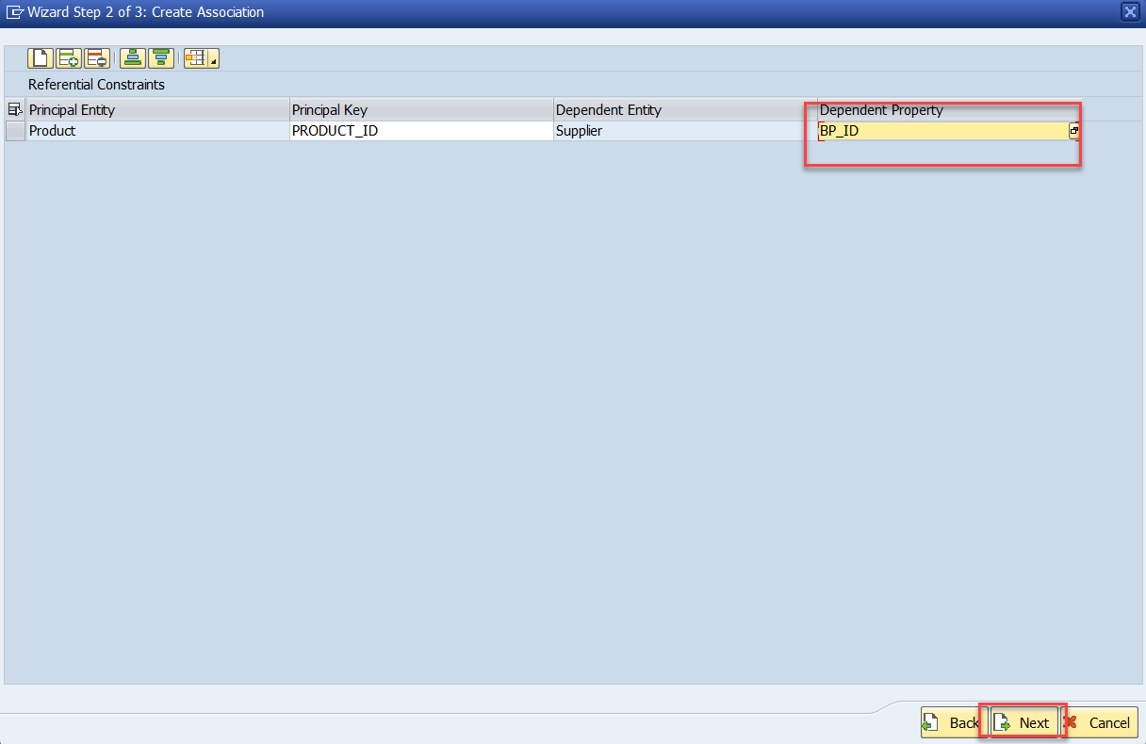
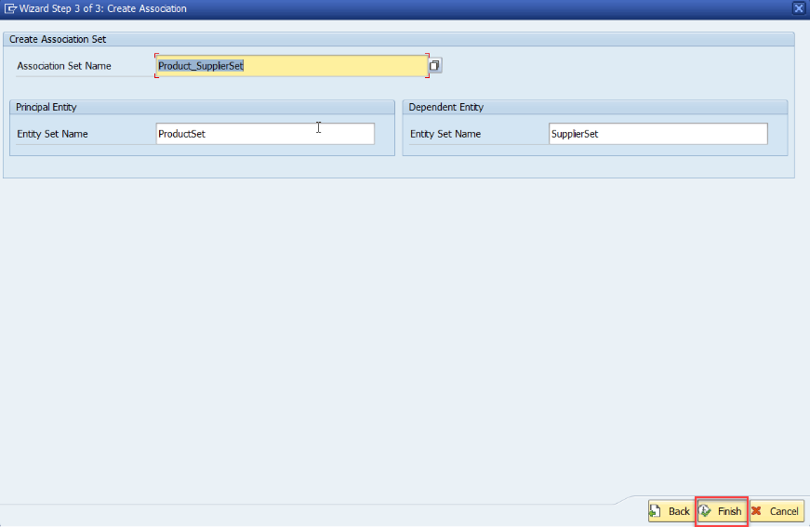
Association (1:1)
Step:1 Right Click on Association and click on create
After creating the Association for Supplier Set in Product Set, we need to change the Supplier Get entity.
SUPPLIER_GET_ENTITY (Association)

Slide 21
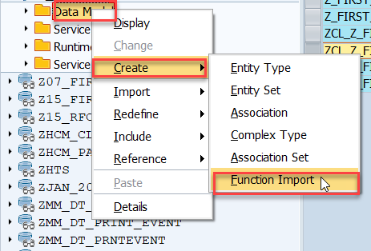
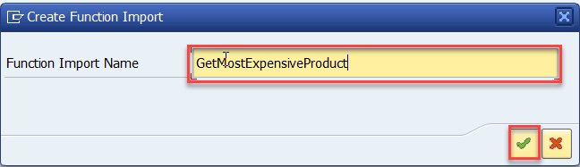
Function Import
At times, we need to implement the logic inside of OData which is not a direct CRUD operation e.g. calling a workflow, calling a BAPI which does some processing, Sending request to another server and can be invoked by the HTTP methods GET or POST .
For example: we can create the function import to GetMostExpensiveProduct in our Product set by the Category.
Step1: Right click the Data Model folder and select Create and then select Function Import. Create Function Import dialog opens

Slide 22
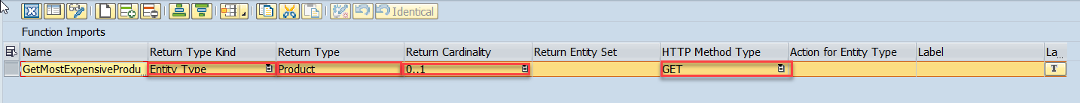
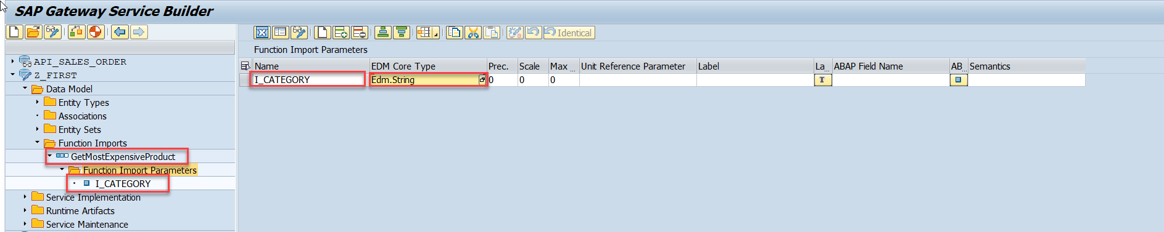
Function Import
Step2: Enter return type kind, return type, return cardinality & HTTP method Type
Step3: Giving function import parameters (I_CATEGORY)

Slide 23
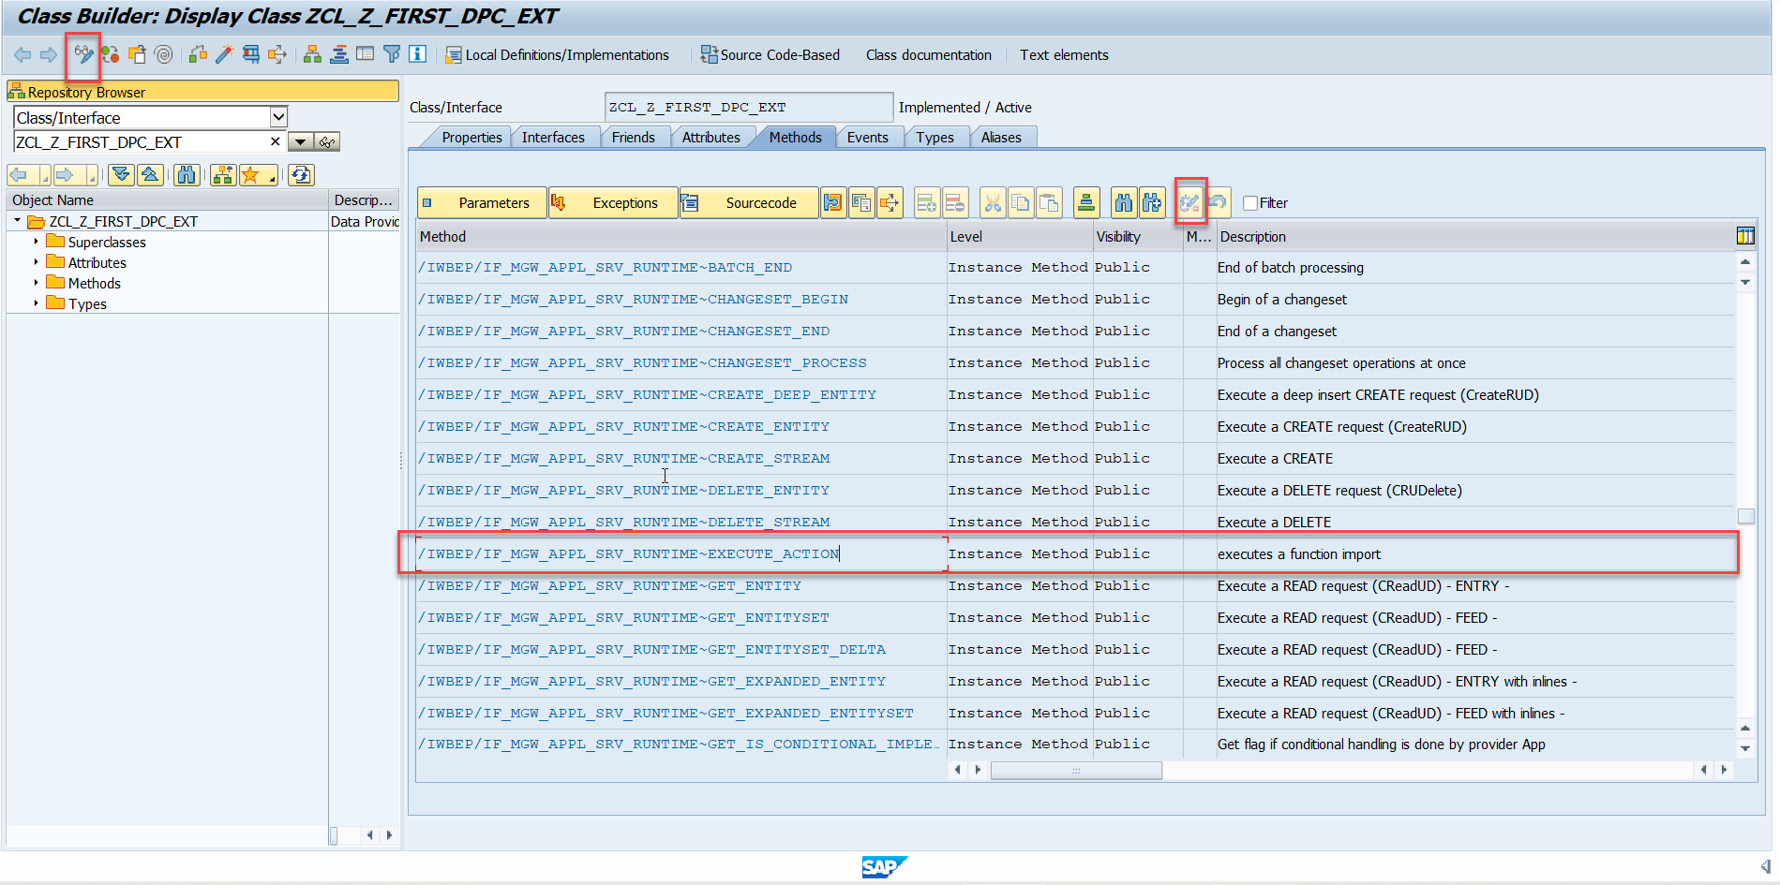
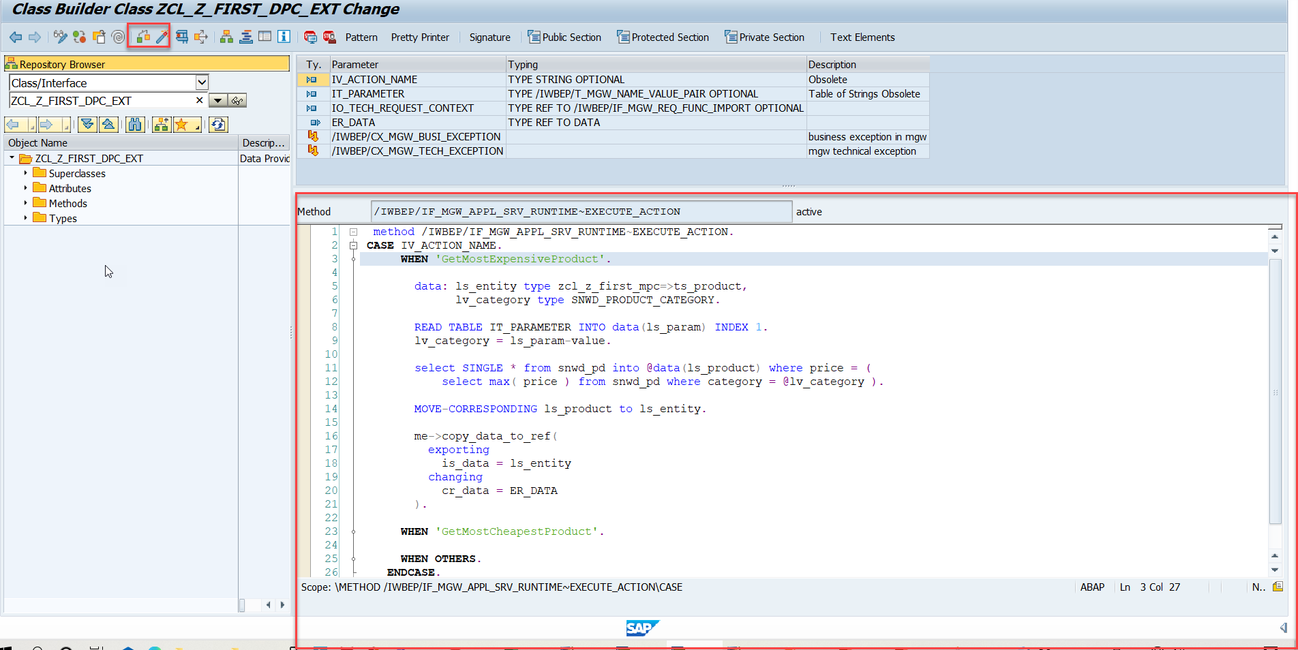
Function Import
Step4: Go to DPC Extension and search for the method--/IWBEP/IF_MGW_APPL_SRV_RUNTIME~EXECUTE_ACTION and redefine the class method
Function Import Code: funciton_import

Slide 24

Basics of Connectivity and Role of SCC
Internet
Intranet
SAP BW
SAP ECC
SAP S/4 Hana
SAP BTP (PublicCloud)
SAP Cloud Connector
SAP On-premise System
SAP Business Application Studio
SCC
Destination
S/4 Hana Cloud
Field Glass
Sales Force

Slide 25
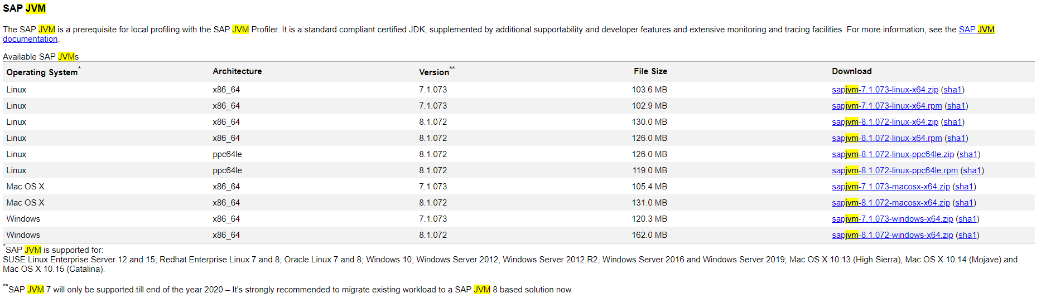
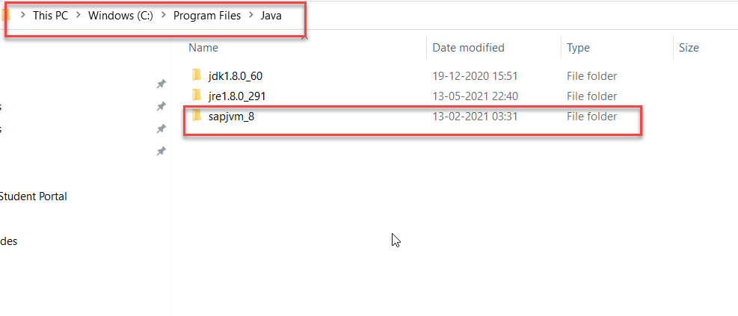
Cloud Connector
Step 1: Download SAP JVM and Extract it in the C:\Program Files\Java

Slide 26
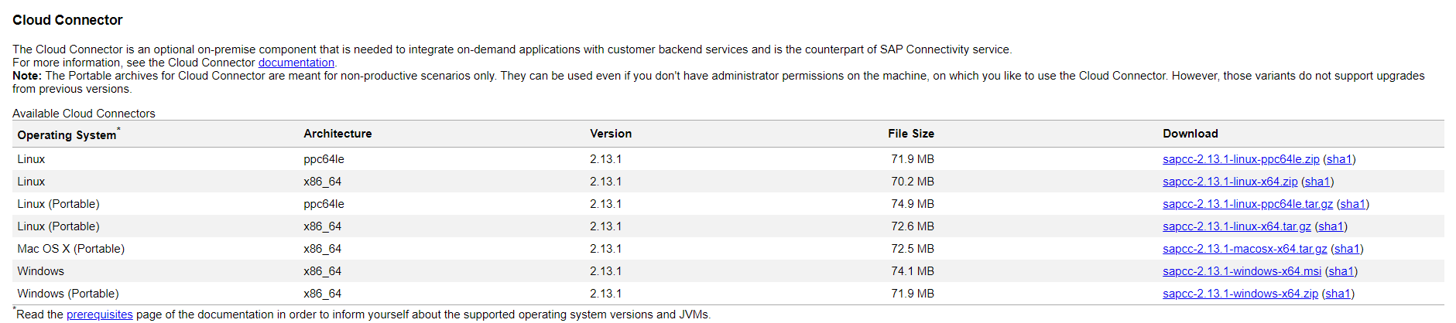
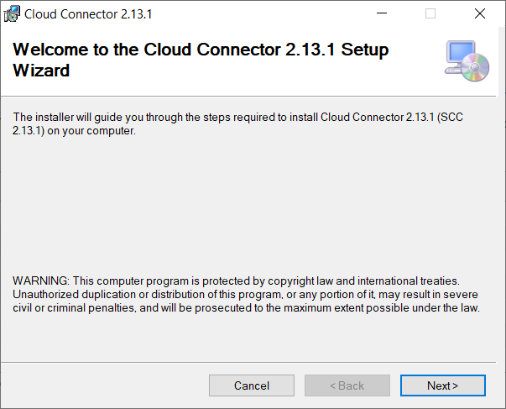
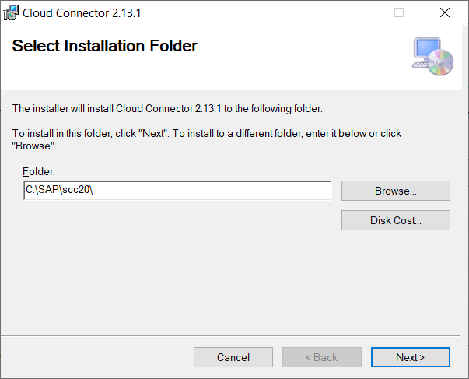
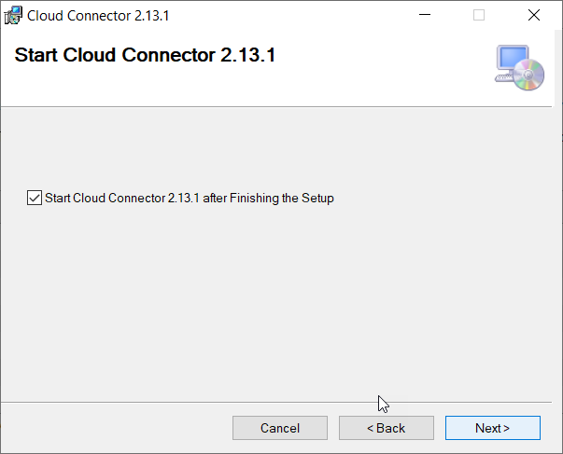
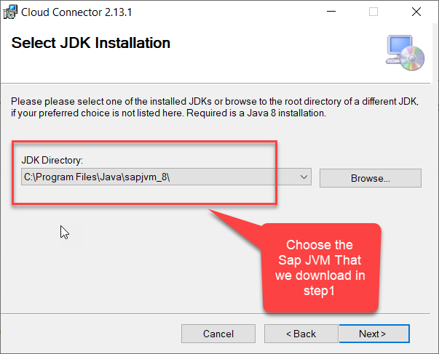
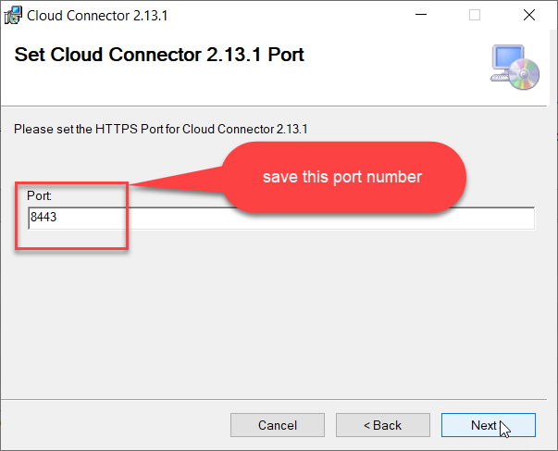
Cloud connector continue…
Step 2: Download and install the sap Cloud connector

Slide 27
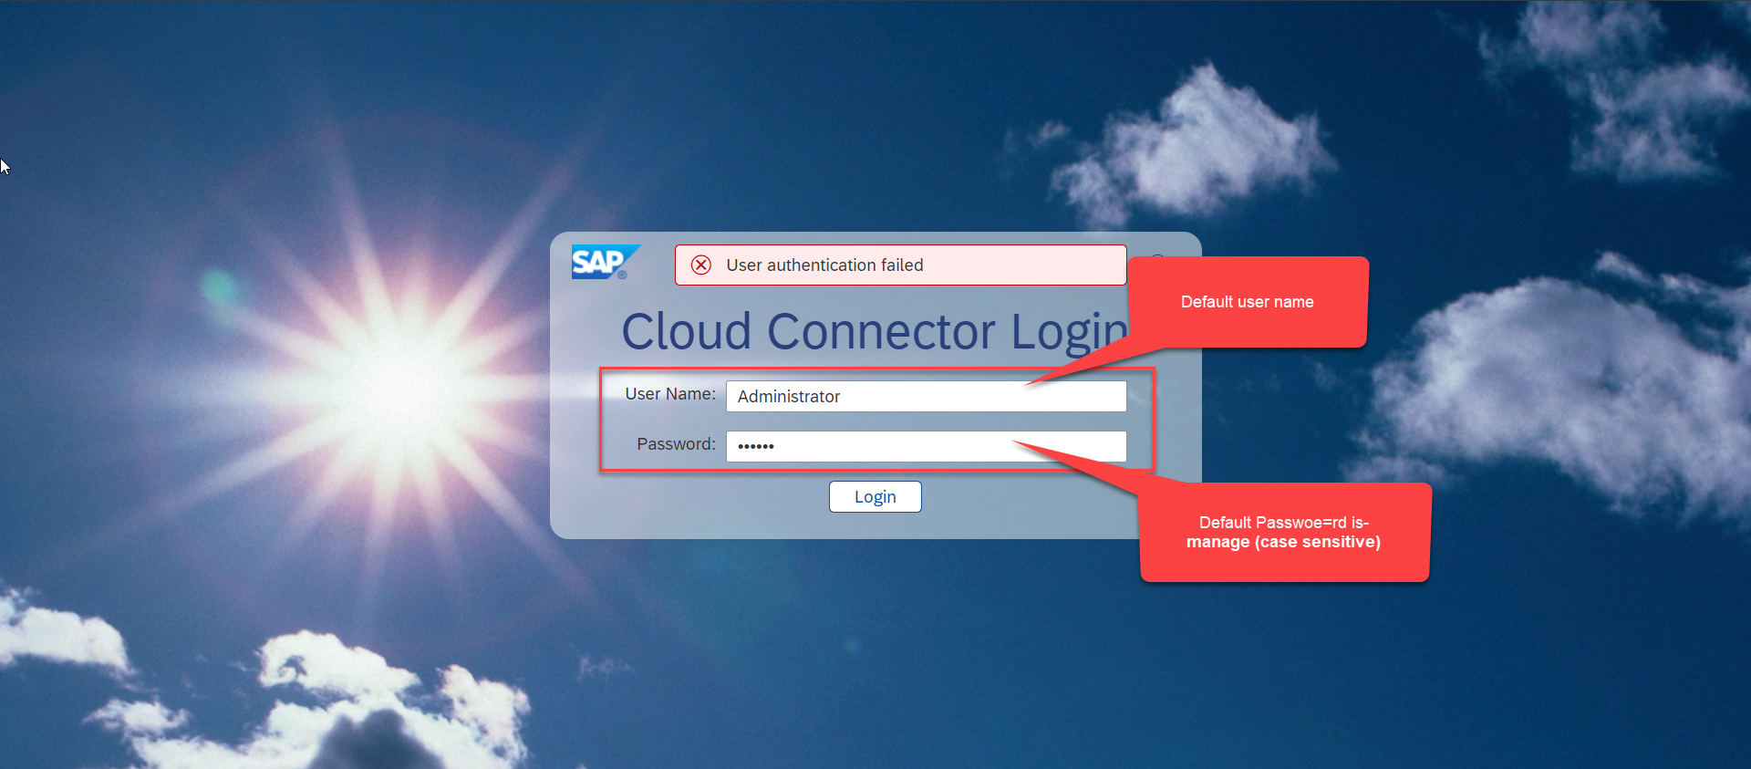
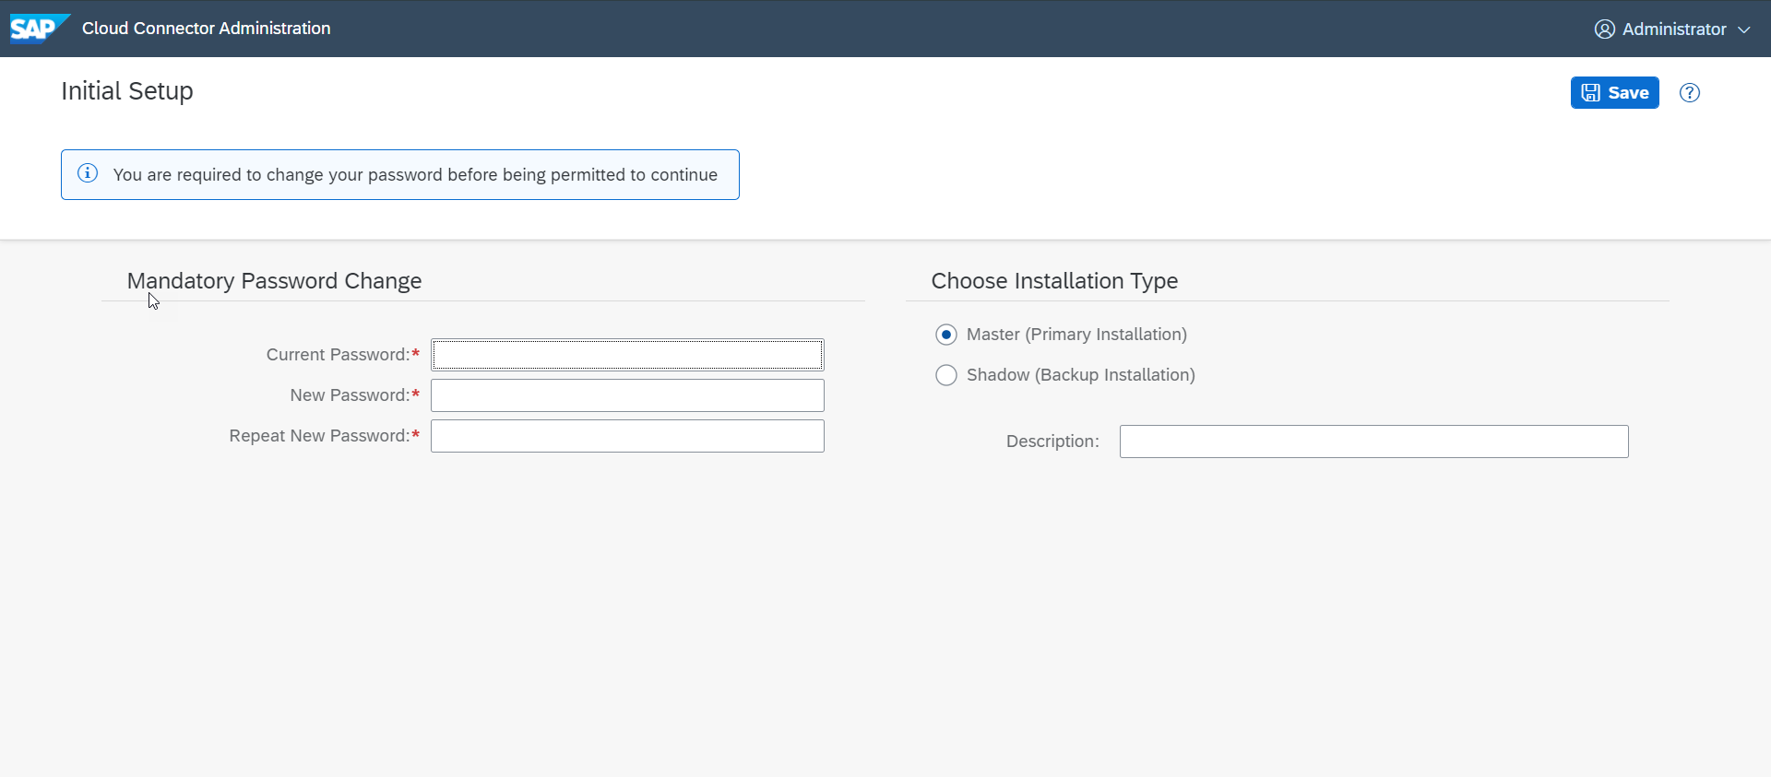
Cloud connector continue…
Step 3: Now your system is ready go to browser and open https://localhost:8443 (port may changes)
The default credentials are Administrator / manage

Slide 28

Cloud connector continue…
Step 4: Now we create a connection with our Cloud Account

Slide 29

Cloud connector continue…
Step 5: Check the connection on Hana Cloud Account

Slide 30








Cloud connector continue…
Step 6: Connect on-premise system to cloud using SCC

Slide 31

Cloud connector completed
We have Done with Connect , now we are now successfully connected to cloud using SCC.

Slide 32
CORS – Cross Origin Resource Sharing
It is a browser security policy which prevent us connecting to a domain while running web page on a different domain.
Browser
S
https://workspaces-ws-7qbs5-app3.eu10.trial.applicationstudio.cloud.sap/
Proxy
Facebook.com
Google.com
Another Server
http://103.207.171.202:8021/sap/opu/odata/sap/ZOCT_ODATA_SRV/$metadata
https://www.npmjs.com/package/@sap/ux-ui5-tooling

Slide 33




Integration of OData in our Fiori Project
Steps to Integrate our Fiori app with the OData service we have created.
Step 1: Go to manifest.json and define a data source in sap.app section.
Step 2: Go to sap.ui5 section and create a default data model for this data source
TO AVOID CORS issue in BAS tool so we can connect to our SAP SERVER
Step 3: Add a dev-dependency in package.json file to latest UI5 tooling - @sap/ux-ui5-tooling
Step 4: Also add a section called UI5 in package.json to use the tooling for the project.
Step 5: We will cheat the browser by adding a proxy module, this proxy module will re-direct all the calls starring /sap top our SAP Server via destination. In ui5.yaml file provide middleware configuration
Step 6: Test app using ui5 serve or fiori run command
Step 7: Binding with ODATA entityset

Slide 34

Configuring ui5.yaml for VS Code
To use the OData service in VS Code we must configure the ui5.yaml file according to that. We need to configure it according to the below format.
specVersion: '2.5'
metadata:
name: fiorilikeapp
type: application
server:
customMiddleware:
- name: fiori-tools-proxy
afterMiddleware: compression
configuration:
ignoreCertError: false
backend:
- path: /sap
url: http://<hostname>:<port>
ui5:
path:
- /resources
- /test-resources
url: https://ui5.sap.com
version:
- name: fiori-tools-appreload
afterMiddleware: compression
configuration:
port: 35729
path: webapp

Slide 35

ui5-local.yaml configuration
To run and access the OData service in application in a local environment we also need a ui5-local.yaml file. The structure of ui5-local.yaml file is shown below:
specVersion: '2.4'
metadata:
name: 'project1'
type: application
framework:
name: SAPUI5
version: '1.97.1'
libraries:
- name: sap.f
- name: sap.m
- name: sap.suite.ui.generic.template
- name: sap.ui.comp
- name: sap.ui.core
- name: sap.ui.generic.app
- name: sap.ui.table
- name: sap.ushell
- name: themelib_sap_fiori_3
server:
customMiddleware:
- name: fiori-tools-proxy
afterMiddleware: compression
configuration:
ignoreCertError: false # If set to true, certificate errors will be ignored. E.g. self-signed certificates will be accepted
backend:
- path: /sap
url: http://103.207.171.202:8021
- name: fiori-tools-appreload
afterMiddleware: compression
configuration:
port: 35729
path: webapp

Slide 36

Exercise: Fiori Integration
In this exercise we will add the configuration to Integrate the OData with our existing app.
And we will bind the View1 with the OData model.
Along with that we will also see how to read the data of a single product.
To do that when we select a product form the product list then the details of that product will be loaded on the View2.
Exercise part 1 code/resource: Configuring the app to access OData and loading the list of products on view1
manifest.json
ui5.yaml
package.json
View1.view.xml
ui5.yaml and ui5-local.yaml config for VS Code
ui5.yaml
ui5-local.yaml
Exercise part 2 code/resource: Getting the data of single product with association To_Supplier on View2.
View1.view.xml
View1.controller.js
View2.view.xml
View2.controller.js
MoreInfo.fragment.xml

Slide 37


Exercise - Implement Create using UI
Now we will implement create operation in the UI. To do that we need to add a new screen in our application. In that screen we will add a simple form to fill the details of the product and a Save button in the footer of that page.
For this have to a new Add button in the footer of the View1 and on press of that button we will navigate to the new Add View.
Exercise code/resource:
View1.view.xml
View1.controller.js
Add.view.xml
Add.controller.js
manifest.json

Slide 38

Exercise – Implementing Update and Delete
Now we want to Update and Delete the selected record form the backend. To do that we will load the data of the record. Once the data is loaded to update and delete the data, we will add two buttons in the footer of the view named as Save and Delete. We will also add a clear button to clear the data of form.
On entering the Product ID of the product in the Input field and press enter we will load the data of that product in the Form.
Exercise code/resource:
Add.view.xml
Add.controller.js

Slide 39
Exercise – Using Function Import from UI
Now we want to Call the function import form the UI. To do that we will add a button near the Product Id input field. On press of that button, we will load the most expensive product in the form.
Exercise code/resource:
Add.view.xml
Add.controller.js

Slide 40

Introduction to Git and GitHub
Git is a version control system that lets you manage and keep track of your source code history.
GitHub is a cloud-based hosting service that lets you manage Git repositories.
Git HUB is a central repository to store all the code. Git is a distributed repository management system, which allows development teams to organize and sync their development code.
Use Case- I am working as a Fiori Developer in an MNC and I want to share my code with fellow developers, currently I am downloading the zip/tar file and sharing over email.
This way we will have piles of emails in our account,
especially when we work in a team of size 40 developers it becomes very hard to sync changes.
There is version control. Last night my app was stable, I made some changes this morning which messed up the whole project. I some how pray to god that can you please take me in past.
In a big team, many developers touching each other’s code and it’s hard to blame someone who disrupt the code.
It is also very hard to merge changes when done in same file.
As a developer, I am using BAS today, tomorrow I will use VS Code and next day Web IDE and very next week Atom. How can I easily port my code between these tools.
You can install git in local machine using below link (however, it comes along with all dev tools)
https://git-scm.com/downloads

Slide 41


How GitHub Works and commands in Git
We will see some important commands related to Git and will see how GitHub works.
Some important commands to use git.
git Init: It is used to initialize a new Git Repository in the system.
git add <filename>: It is used to stage the changes of the file to git repository. We can use ‘git add .’ to stage the changes of all files.
git commit: It is used to commit all the staged changes with a message.
git reset hard: Discard all the staged changes and discard the changes in all the files.
git push: It is used to push all the changes in the git repository.
git pull: It is used to pull the new changes made by other users in the project.
git status: It is used to check the status
git clone: It is used to clone a repository.
git remote add <repo URL>: Add a local repository to a remote repository.
Fiori Project (or any kind of project)
User (Anubhav)
But how all users will work on the project at a same time?
Anubhav’s local machine
Here GitHub comes into picture
Users which are working on the different parts of the same project on different Platforms (BAS, VS Code, Web IDE)
Project Repository
The project will be kept in a repository in the GitHub

Slide 42





Steps to Create a new git Repository
Step by Step process to create a git repository in GitHub. First of all you must have a GitHub account, if not then go to this link https://github.com/signup?source=login and create a new Account.
Step 1: Click on the plus button in the top right corner of the screen and select ‘New Repository’.
Step 2: Type a short, memorable name for your repository. And give a description (optional).
Step 3: Select the type of repository. Public or Private
Step 4: Set how you want to Initialize the repository.
Step 5: Click on Create Repository. Your Repository will be created.
Repository Created Successfully

Slide 43


Adding project to git repository
Project on Local System
1
git init
Initialize a git repo
2
git add .
Stage all the changes
3
git commit –m “message”
git pull
Once the project is connected to git repo then we just use the git pull and git push commands to get the new changes and send our changes
Stage all the changes
git push
5
git add remote <repo URL>
Add the remote branch
GitHub Repository
git push
5
Clone repository for the first time in system
git clone <repo URL>
GitHub Repository

Slide 44

End of Day 15

Slide 45

Questions

Slide 46

Anubhav Oberoy

Slide 47


We’re committed to empower you to be
Most Desirable Resource
through powerful training solutions.
We build the workforce of the future.
250+
Corporate Clients
30,000+
Learners Trained
25000+
Learners Placed
FREE WEBINARS
Sign up for free webinars with industry experts every fortnight!
Enroll Now!
Contact us today!
https://anubhavtrainings.com/

Slide 48




More from AnubhavTrainings.com

Slide 49
Title
Content

